Slide 1

CO1-ASSESSMENT TOOL-3 (TECHNICAL PRESENTATION)
Artificial Intelligence for Network Traffic Management
Presented by
RUCHITA.S (192572081)
CSA0706-COMPUTER NETWORKS

Slide 2

INTRODUCTION
Network traffic refers to the movement of data between computers, servers, and other network devices.
The rapid growth of the Internet, cloud computing, IoT, and 5G has significantly increased network traffic.
Traditional traffic management techniques are unable to efficiently handle dynamic and unpredictable traffic patterns.
Artificial Intelligence (AI) provides intelligent solutions by analyzing network data and making real-time decisions.
AI improves network performance by reducing congestion and optimizing the use of available resources.
AI-based traffic management enables networks to become more reliable, efficient, and self-adaptive.

Slide 3
NETWORK TRAFFIC MANAEGMENT
Network traffic management is the process of monitoring, controlling, and optimizing the flow of data across a network.
It ensures that network resources are efficiently utilized without causing congestion.
Traffic management helps maintain high network performance even during peak usage periods.
It prioritizes important applications such as video conferencing and online banking.
It reduces packet loss and minimizes communication delays.
It also improves bandwidth utilization and maintains Quality of Service (QoS).

Slide 4

NEED FOR AI IN NETWORK TRAFFIC MANAGEMENT
AI continuously monitors network performance and automatically detects traffic congestion.
Modern networks generate huge volumes of traffic that are difficult to manage manually.
Traditional traffic management systems rely on fixed rules that cannot adapt to changing network conditions.
AI predicts future network traffic before congestion actually occurs.
AI minimizes human intervention by making intelligent decisions in real time.

Slide 5
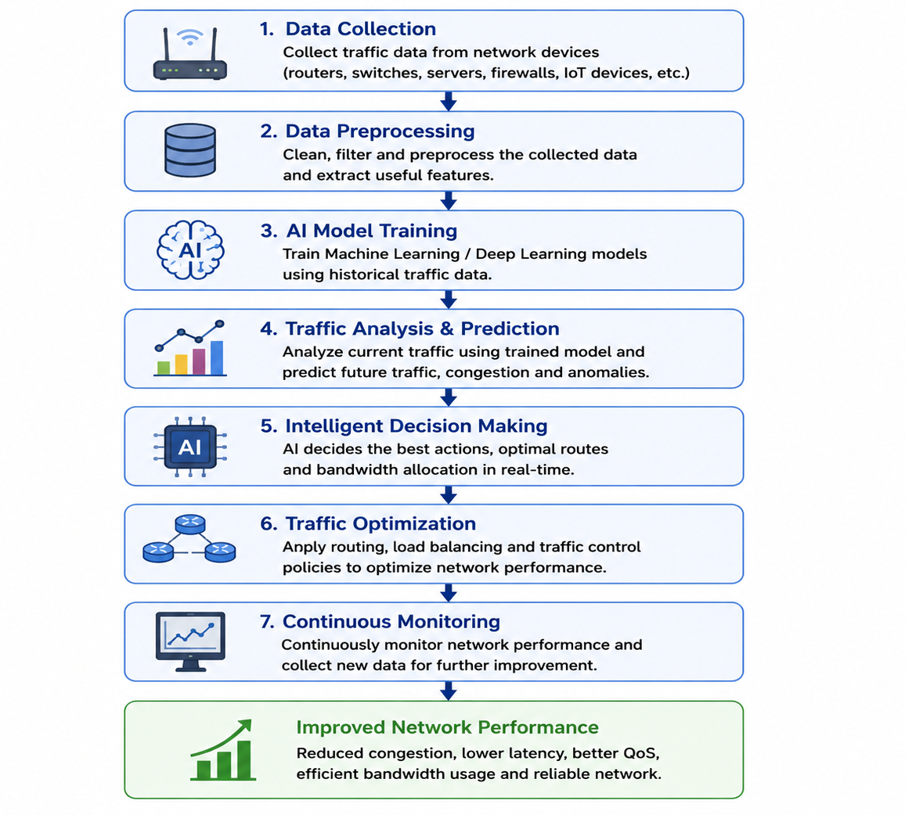
WORKING OF AI-BASED TRAFFIC MANAGEMENT

Slide 6
AI TECHNIQUES USED
Machine Learning predicts network traffic using historical data.
Deep Learning identifies complex traffic patterns and detects anomalies.
Reinforcement Learning learns the best routing strategies through continuous feedback.
Neural Networks improve traffic forecasting by analyzing large datasets.
Fuzzy Logic helps make decisions when network conditions are uncertain.
Genetic Algorithms optimize routing paths to improve network performance.
These AI techniques work together to provide intelligent traffic management.

Slide 7

APPLICATIONS
AI is widely used in 5G networks to manage high-speed communication efficiently.
Cloud service providers use AI to balance workloads across multiple servers.
Data centers rely on AI to optimize resource utilization and reduce energy consumption.
AI helps IoT networks manage communication between millions of connected devices.
Smart cities use AI to support intelligent transportation and surveillance systems.

Slide 8
ADVANTAGES AND CHALLENGES
ADVANTAGES
CHALLENGES
Real-time traffic monitoring
Reduced network congestion
Better bandwidth utilization
Lower latency
Improved Quality of Service
Automatic fault detection
Increased security
Large amount of training data required
High implementation cost
Privacy concerns
Cybersecurity risks
Model accuracy
Computational complexity
Integration with legacy networks

Slide 9

FUTURE SCOPE
Future 6G communication systems will depend heavily on AI for intelligent traffic management.
Edge AI will reduce network delays by processing data closer to users.
AI will improve cybersecurity through advanced threat prediction and prevention.
AI will help reduce energy consumption by optimizing network resources.
Future networks will become faster, more secure, and highly efficient through AI-driven automation.

Slide 10
CONCLUSION
Artificial Intelligence has transformed the way modern networks are managed.
AI enables networks to analyze traffic, predict congestion, and optimize routing automatically.
It improves bandwidth utilization, reduces delays, and enhances Quality of Service.
AI also strengthens network security by detecting abnormal traffic and preventing attacks.
AI-based network traffic management is becoming an essential technology for future communication networks.
As networking technologies continue to grow, AI will play a vital role in building intelligent and reliable digital infrastructures.

Slide 11
THANK YOU

